Slide 1
AVL TREE Operations

Slide 2
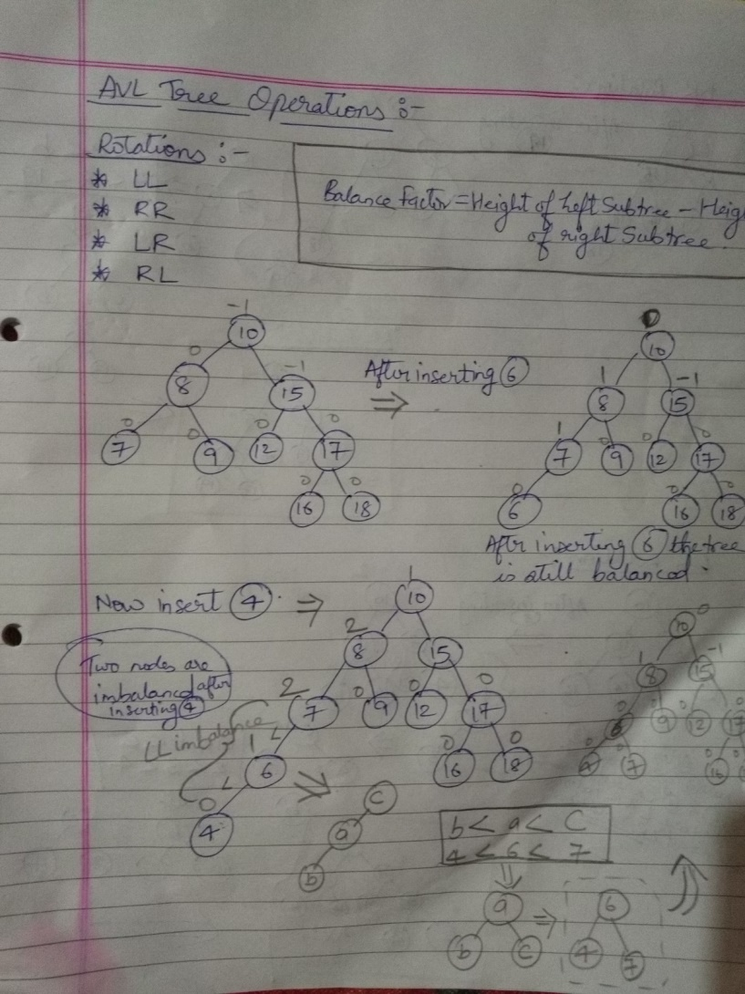

Slide 3
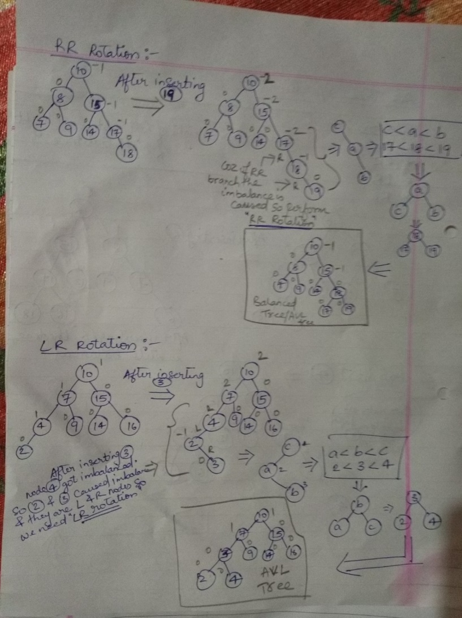

Slide 4
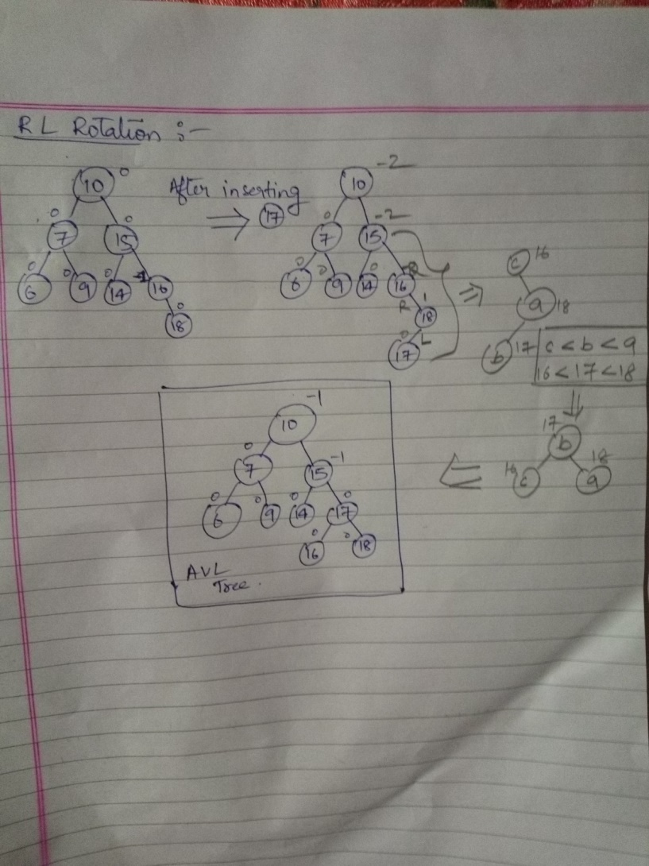

Slide 5
Splay Tree
Splay tree is another variant of a binary search tree. In a splay tree, recently accessed element is placed at the root of the tree. A splay tree is defined as follows...
Splay Tree is a self - adjusted Binary Search Tree in which every operation on element rearranges the tree so that the element is placed at the root position of the tree.
In a splay tree, every operation is performed at the root of the tree. All the operations in splay tree are involved with a common operation called "Splaying".

Slide 6
Splaying an element, is the process of bringing it to the root position by performing suitable rotation operations.

Slide 7
Rotations in Splay Tree
1. Zig Rotation
2. Zag Rotation
3. Zig - Zig Rotation
4. Zag - Zag Rotation
5. Zig - Zag Rotation
6. Zag - Zig Rotation

Slide 8
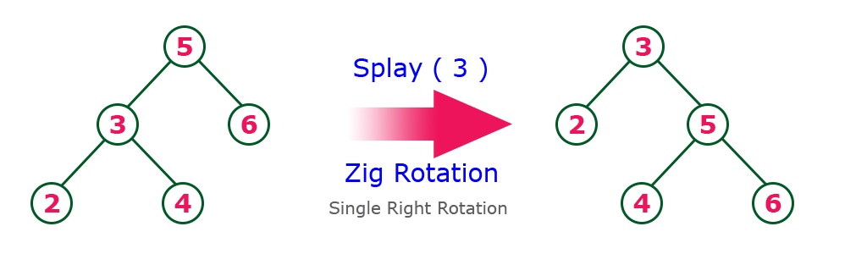
Zig Rotation
The Zig Rotation in splay tree is similar to the single right rotation in AVL Tree rotations. In zig rotation, every node moves one position to the right from its current position. Consider the following example...

Slide 9
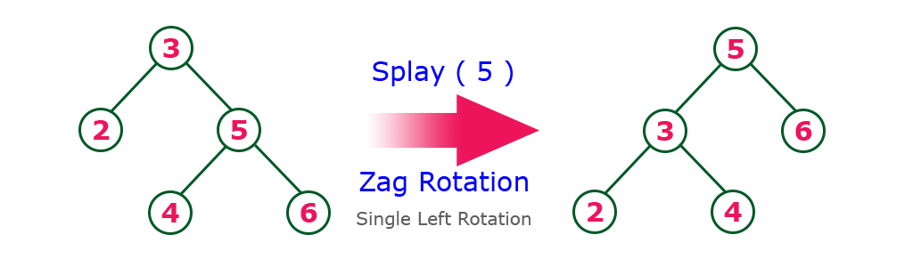
Zag Rotation
The Zag Rotation in splay tree is similar to the single left rotation in AVL Tree rotations. In zag rotation, every node moves one position to the left from its current position. Consider the following example...

Slide 11
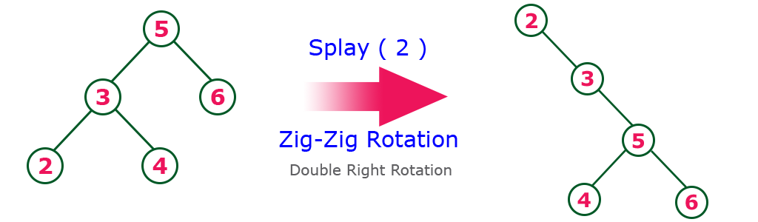
Zig-Zig Rotation
The Zig-Zig Rotation in splay tree is a double zig rotation. In zig-zig rotation, every node moves two positions to the right from its current position. Consider the following example...

Slide 12
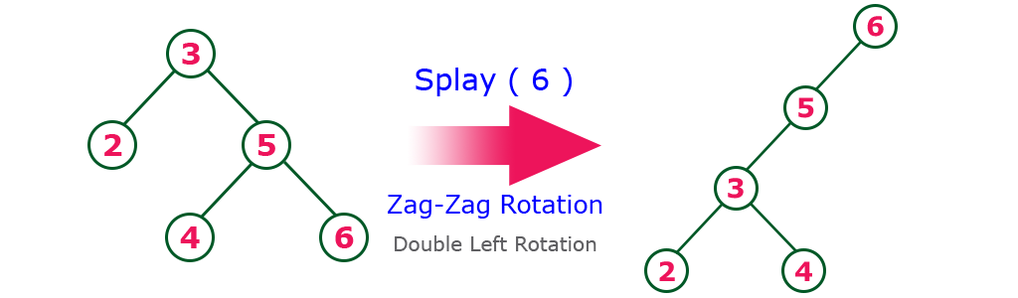
Zag-Zag Rotation
The Zag-Zag Rotation in splay tree is a double zag rotation. In zag-zag rotation, every node moves two positions to the left from its current position. Consider the following example...

Slide 13
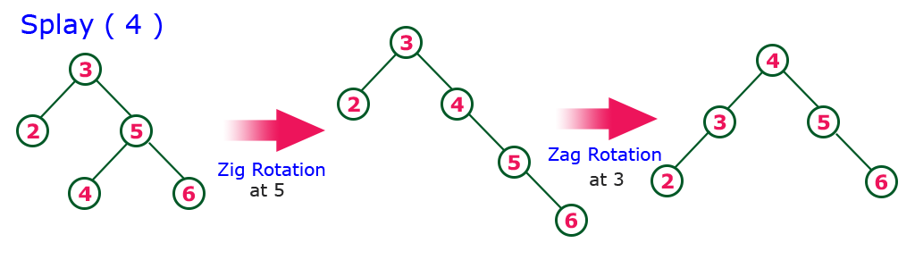
Zig-Zag Rotation
The Zig-Zag Rotation in splay tree is a sequence of zig rotation followed by zag rotation. In zig-zag rotation, every node moves one position to the right followed by one position to the left from its current position. Consider the following example...

Slide 14
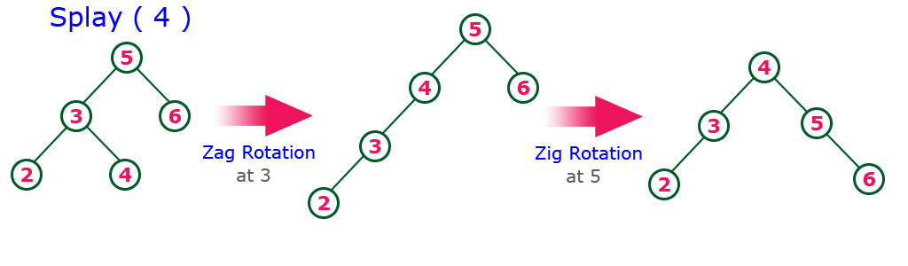
Zag-Zig Rotation
The Zag-Zig Rotation in splay tree is a sequence of zag rotation followed by zig rotation. In zag-zig rotation, every node moves one position to the left followed by one position to the right from its current position. Consider the following example...

Slide 15
THANK YOU!!

